Slide 1


GRE Over IPSEC
MODEL

Slide 2
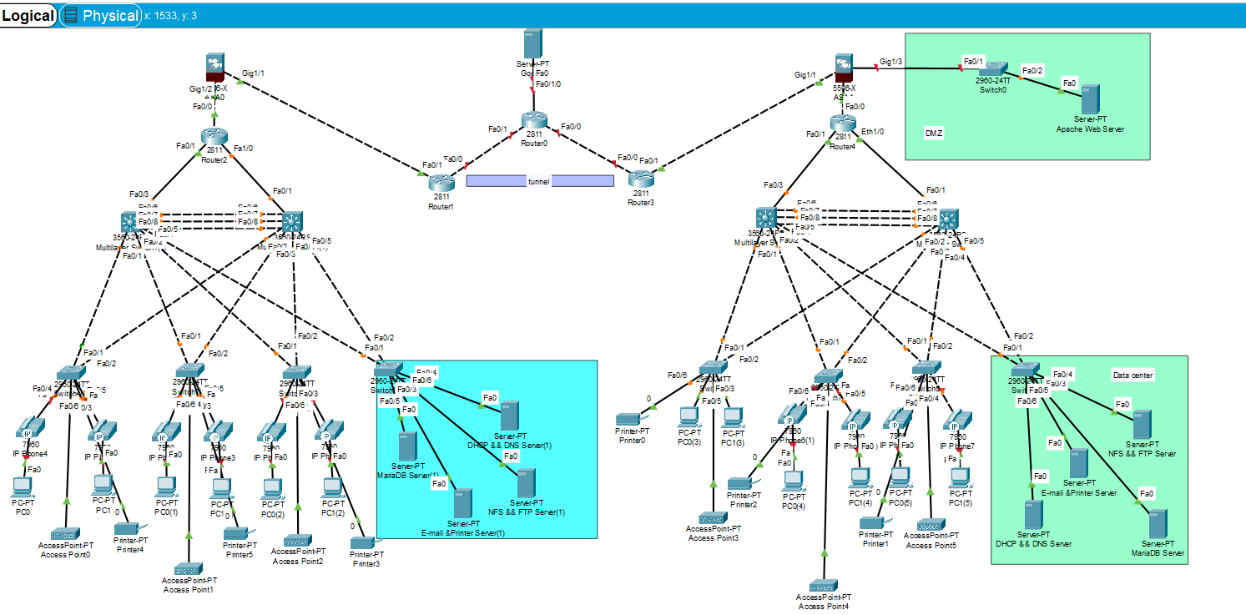

Slide 3
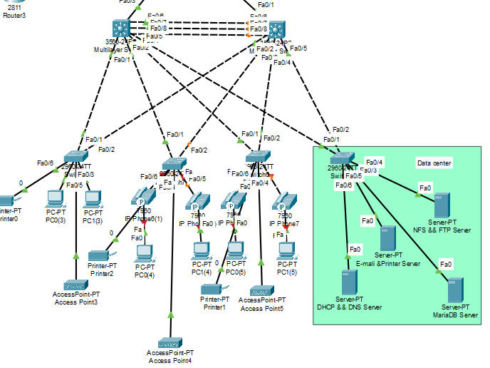

Slide 4
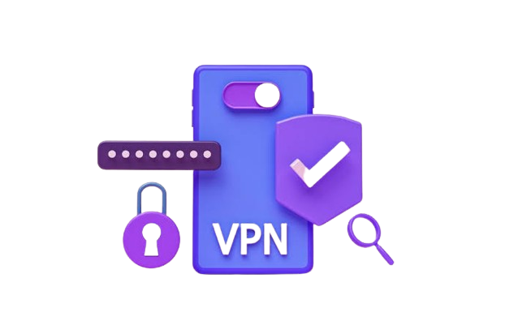

Slide 5

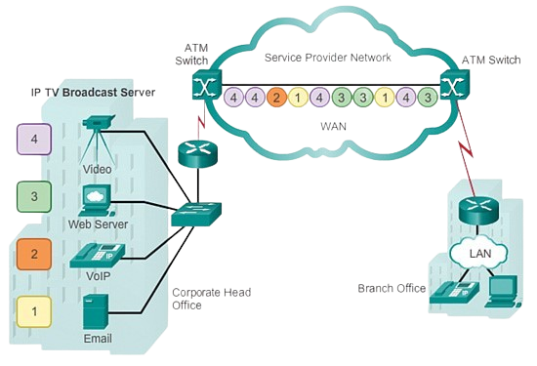

Public VS Private wan A private WAN is a network that is operated and owned by a single organization or entity. Itis designed to connect the various locations, such as branch offices, data centers, or other facilities of a specific organization A public WAN refers to a network that is shared among multiple organizations or the general public. The Internet is the most common example of a public WAN.

Slide 6
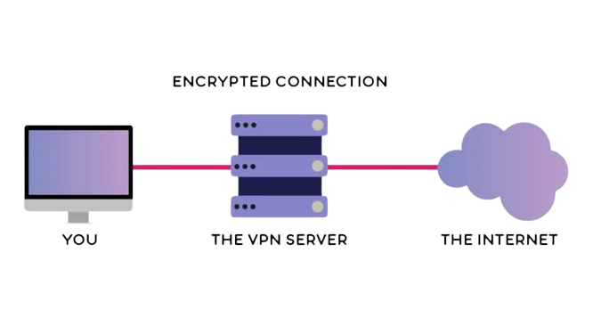
What Vpn A virtual private network (VPN) is a mechanism for creating a secure connection between a computing device and a computer network, or between two networks, using an insecure communication medium such as the public Internet.

Slide 7
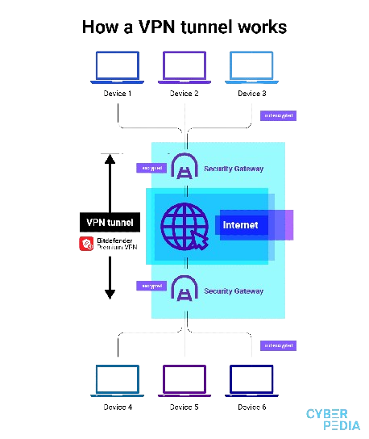
How Vpn work ? a VPN works by creating a secure and encrypted connection between your device and a remote server. This ensures that your internet traffic is protected from potential eavesdropping

Slide 8

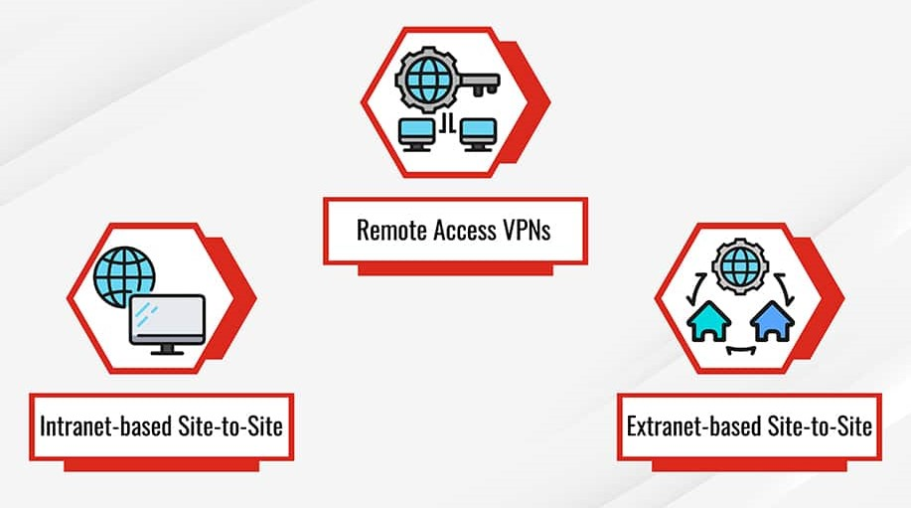
Type of VPN
Remote Access VPN
Site-to-Site VPN
Intranet-based VPN
Extranet-based VPN

Slide 9
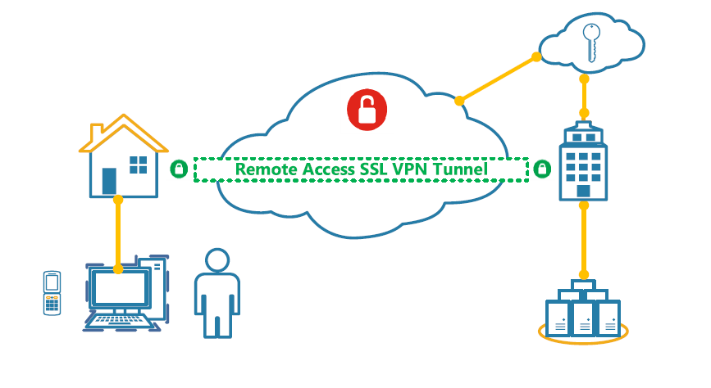
Remote Access VPN: Allows individual users to connect to a private network remotely over the internet.

Slide 10
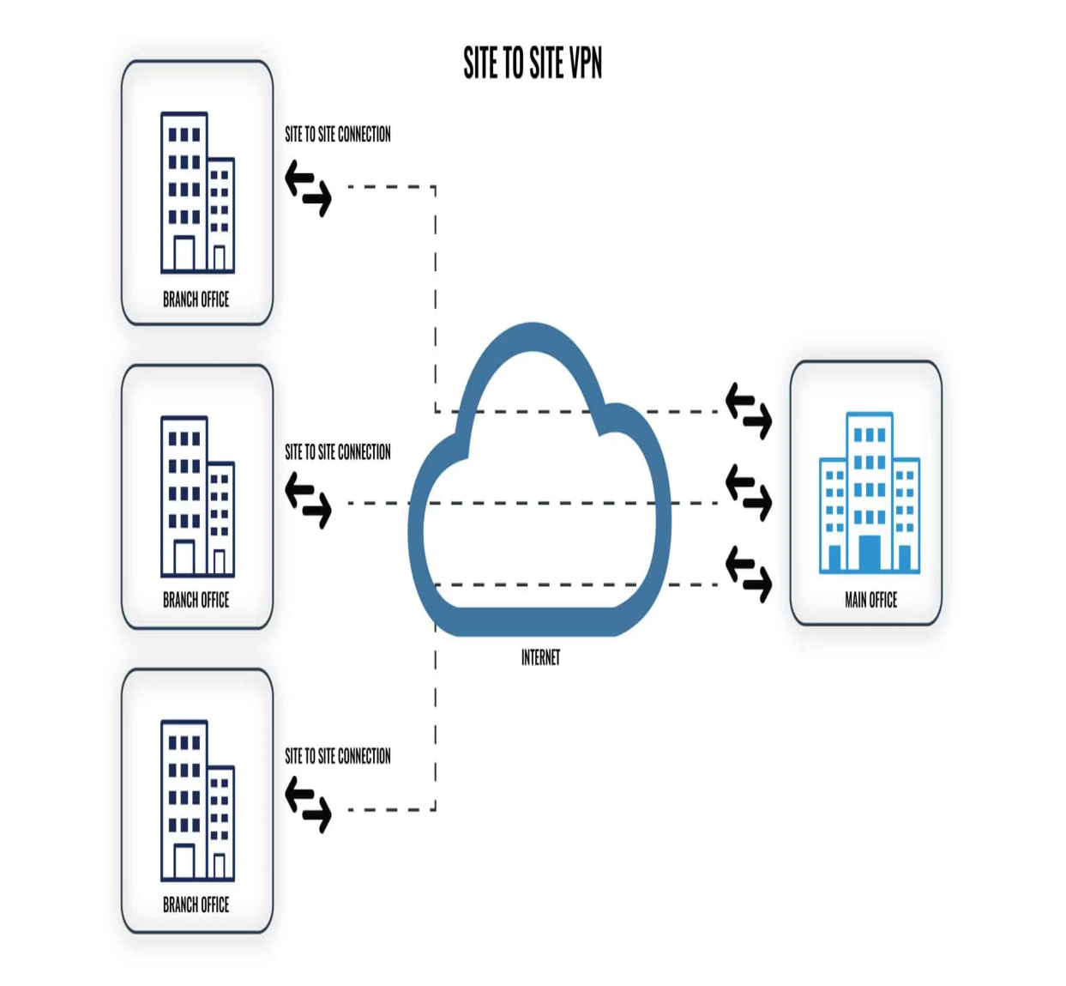
Site-to-Site VPN: Establishes secure connections between two or more networks, often used for interconnecting branch offices 1. Intranet-based VPN 2. Extranet-based VPN

Slide 11
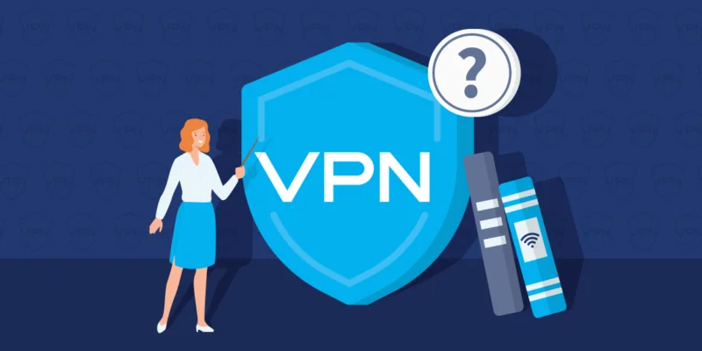
VPN function
Confidentiality
Integrity
Authentication
Anti replay

Slide 12
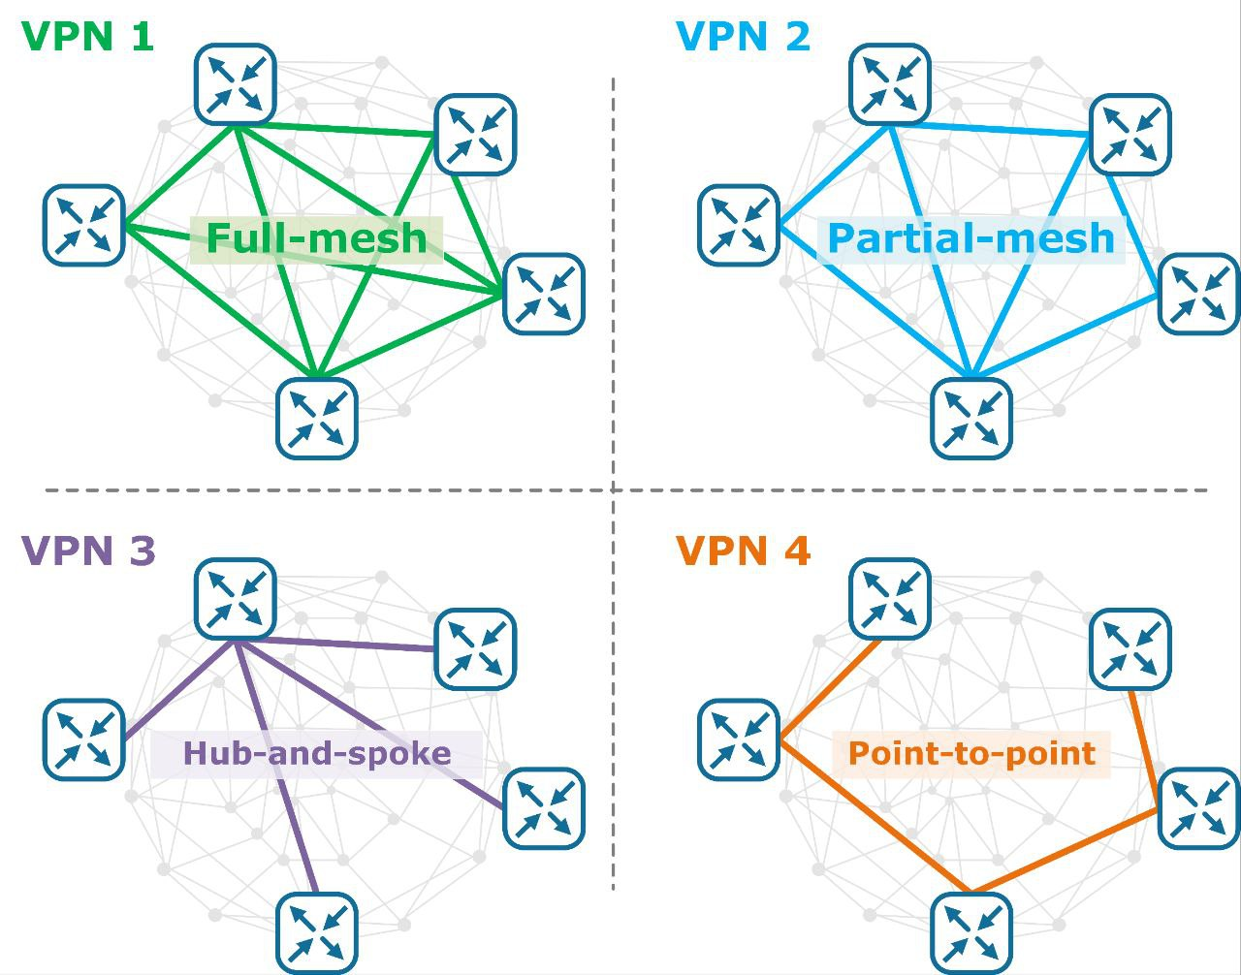
VPN topologies
1. Hub-and-Spoke Topology
2. Full Mesh VPN Topology
3. Partial Mesh Topology

Slide 13
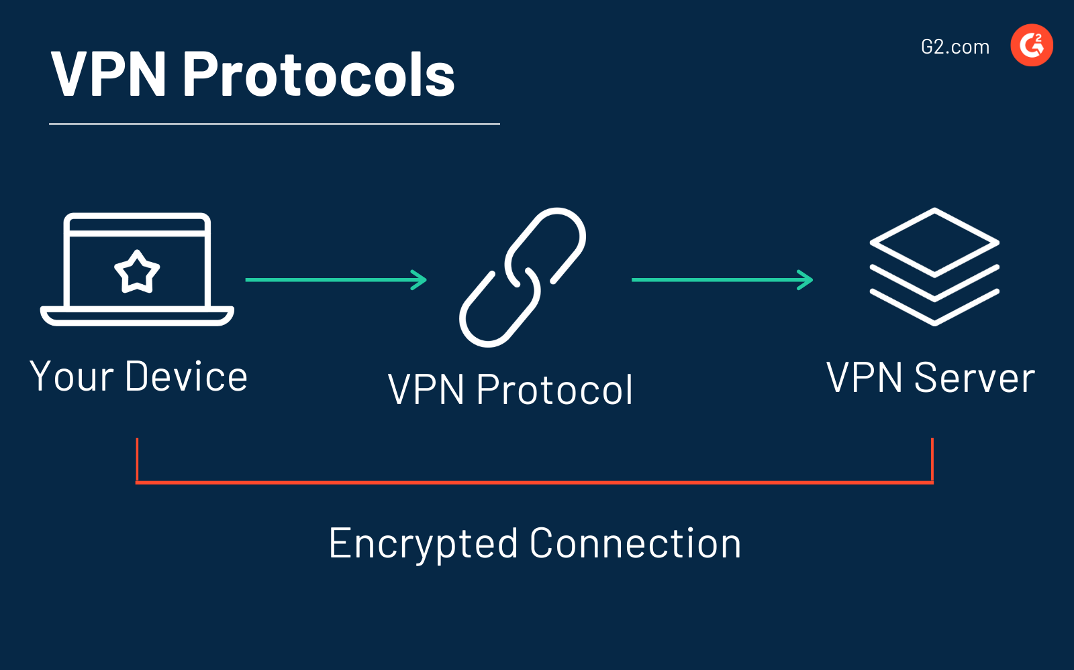
VPN protocols A Virtual Private Network (VPN) protocol refers to the set of rules and procedures that govern the communication and security aspects of a VPN connection. VPNs are used to create a secure and encrypted connection over an unsecured network,

Slide 14
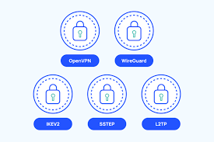
GRE:Generic Routing Encapsulation
PPTP:- Point-to-point tunneling protocol
L2TP:- Layer to Tunneling Protocol
IPsec:- Internet protocol security
SSL:- is not used as much as The ones above
SSTP (Secure Socket Tunneling Protocol)
(How to create the tunnel)

Slide 15
Why VPN?
All traffic is encrypted
full internet access
lower cost
tunnel topology

Slide 16
Conclusion In summary, a Virtual Private Network (VPN) is a technology that establishes a secure and encrypted connection over the internet or another untrusted network. VPNs are used to enhance privacy, security, and anonymity for users by encrypting their data and masking their IP addresses.

Slide 17
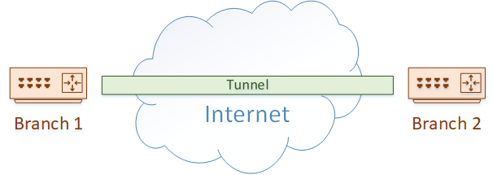
GRE (Generic Routing Encapsulation) Tunneling protocol : encapsulating certain layer into another layer Generic Routing Encapsulation (GRE) is a tunneling protocol . , is one of the technologies that we use to build these tunnels.

Slide 18
GRE does not inherently provide encryption or security features. If secure communication is required, additional protocols such as IPSEC need to be implemented in conjunction with GRE.

Slide 19

IPsec

Slide 20
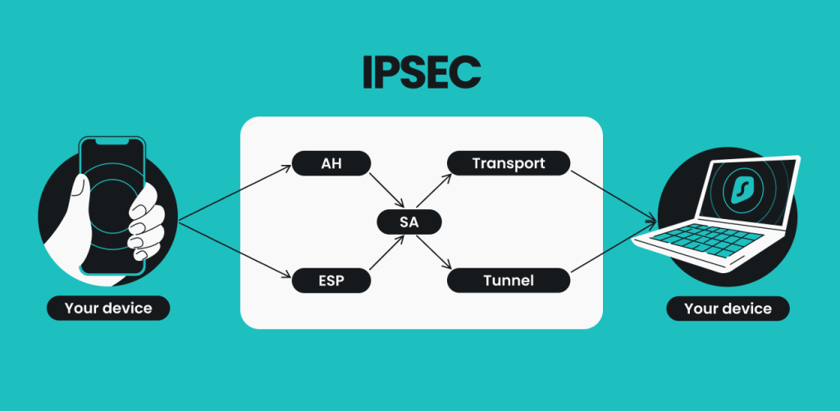
What is IPsec (Internet Protocol Security)?
IPsec (Internet Protocol Security) is a suite of protocols and algorithms for securing data transmitted over the internet or any public network.

Slide 21
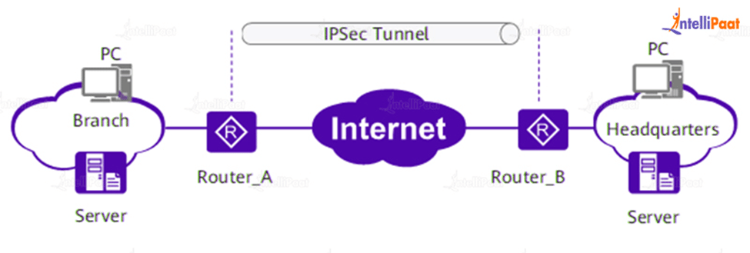
Interesting traffic
Negotiation
IPSec circuit
Data transfer
Tunnel termination
How does IPsec work?

Slide 22
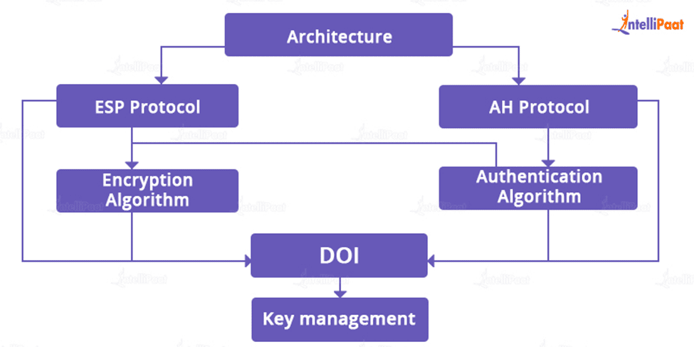
IPsec protocols:
Security Association (SA)
Authentication Header (AH)
Encapsulating Security Protocol (ESP)

Slide 23
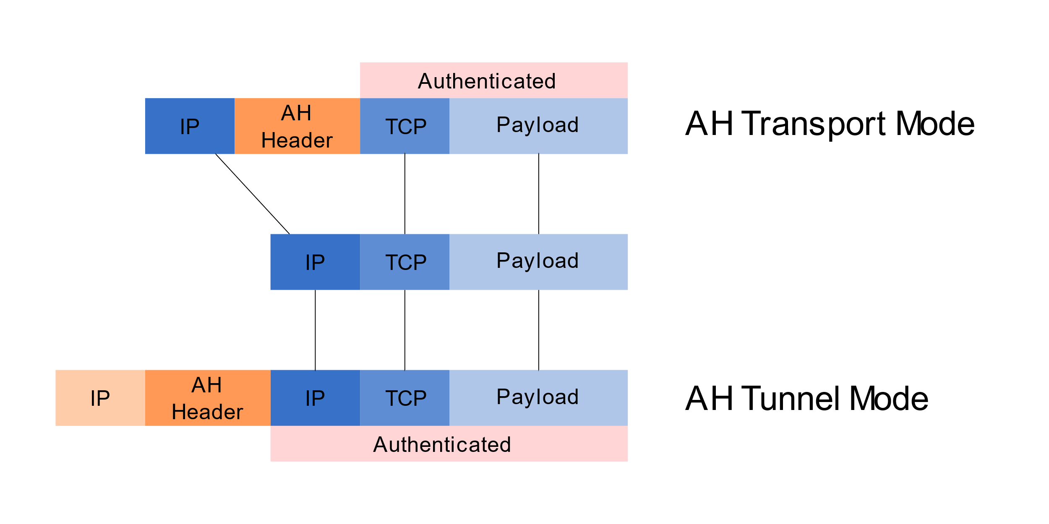
IPsec modes IPsec tunnel mode: is used between two dedicated routers In transport mode: the payload of each packet is encrypted, but the original IP header is not. Intermediary routers are thus able to view the final destination of each packet

Slide 24

VoIP
What is voip?
VoIP is a technology that allows you to make phone calls using the internet instead of traditional telephone lines.

Slide 25
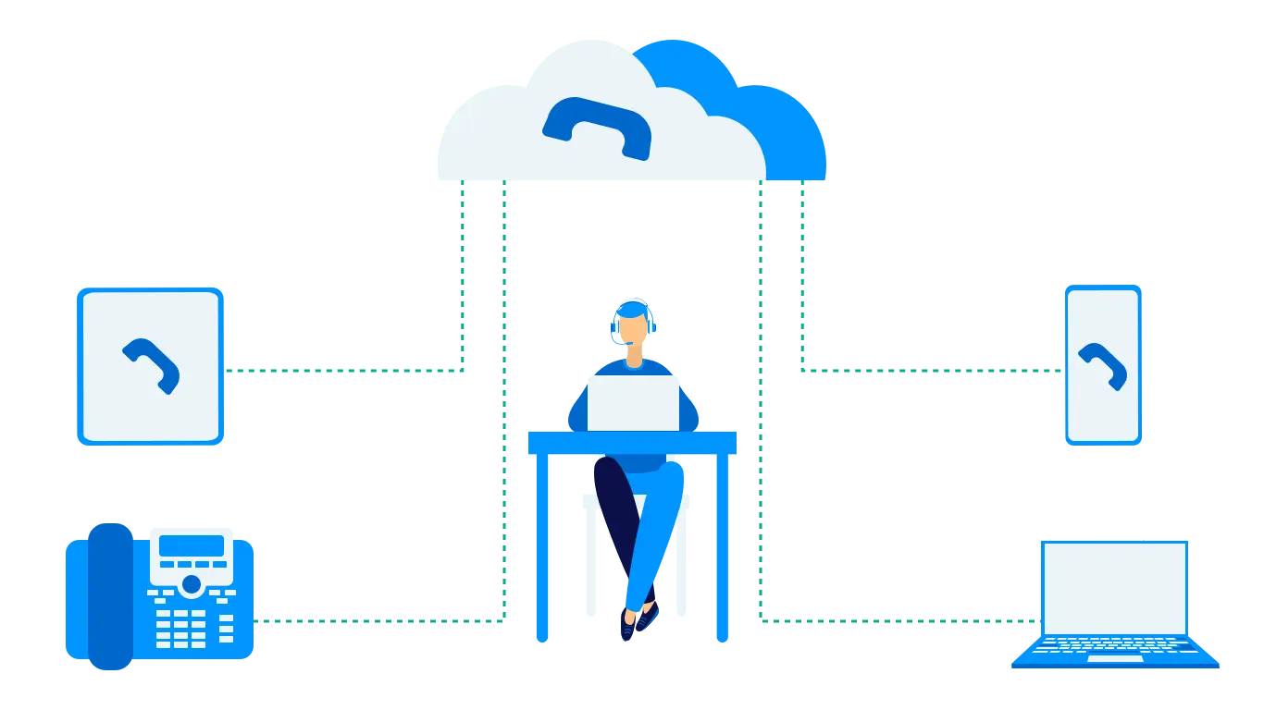
Voice-over-Internet Protocol converts the voice signal used in traditional phone technology into a digital signal that travels through the Internet instead of through analog telephone lines.

Slide 26
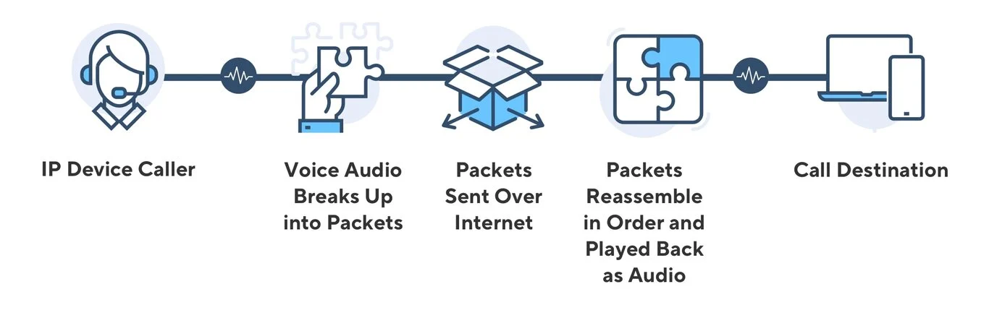
How Does VoIP Work
VoIP converts your voice into a digital format, compresses it, and sends it over the internet.

Slide 27
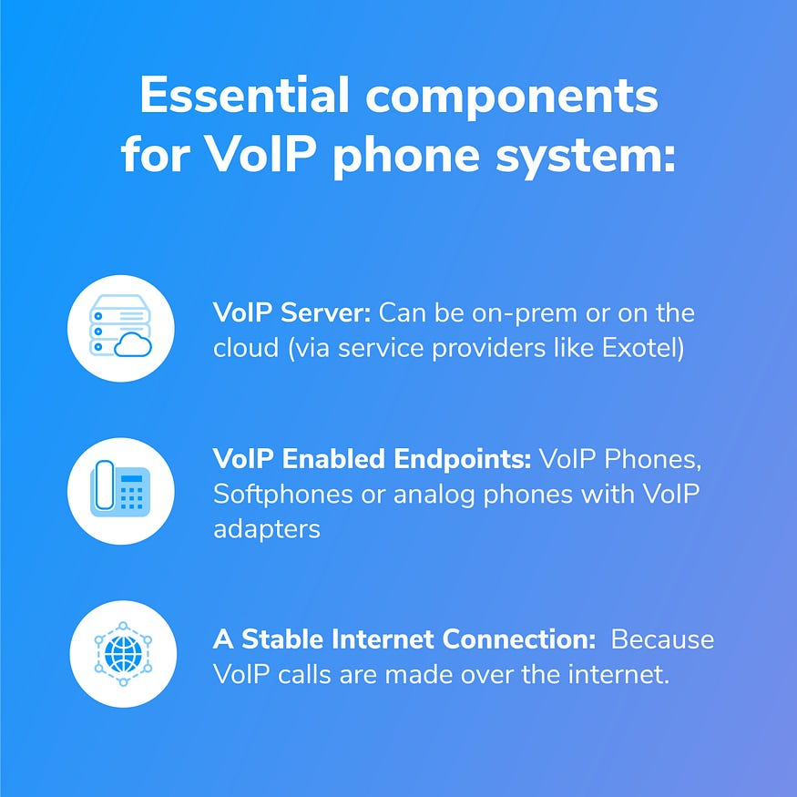
Essential components for VoIP calling

Slide 28
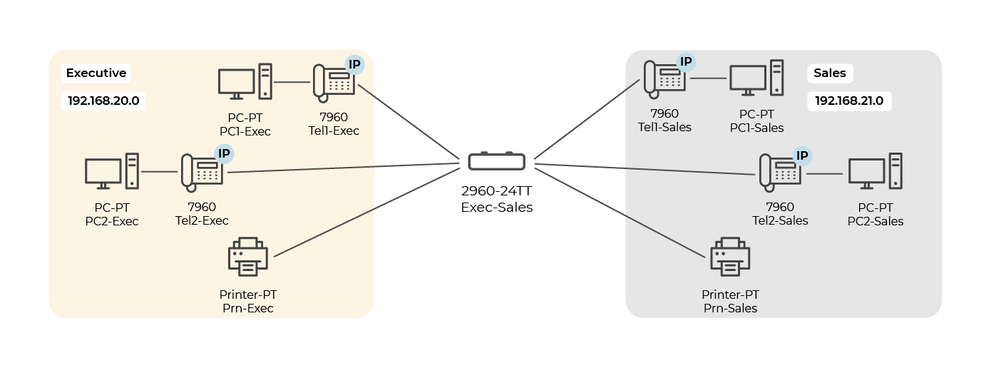
Design for simplicity

Slide 29
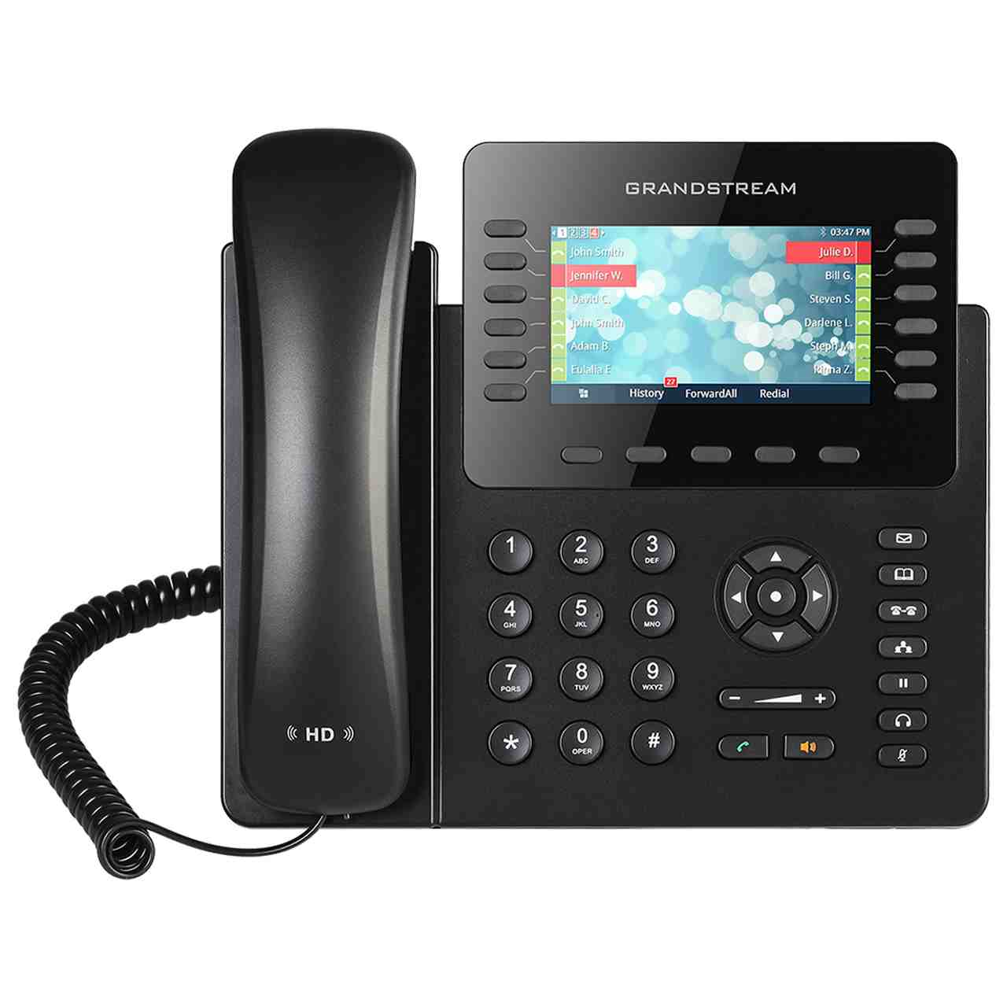
Ip phone

Slide 30
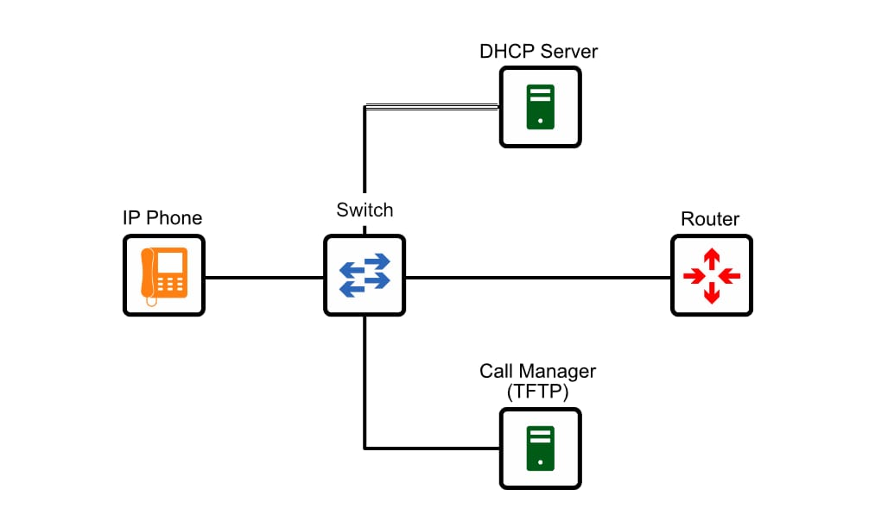
Booting process for ip phone
POE
Getting Vlan ID
DHCP Request (Option 150 Enabled
Getting Conf. File From FTP
Connect to The CM
Registeration Completed

Slide 31
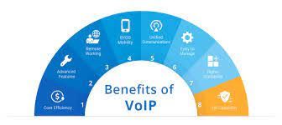
Advantages of Voice over IP
Lower cost
High –quality sound
Call any one worldwide
Easy to manage

Slide 32
Requires stable internet connection
Jitter, latency, and dropped calls possible
No Internet, No Phone
Poor Internet connection leads to a poor phone connection
Disadvantages of VoIP

Slide 33

Firewall

Slide 34
What is a firewall
A firewall is a network security device that monitors incoming and outgoing network traffic and decides whether to allow or block specific traffic based on a defined set of security rules

Slide 35
features of next-gen firewall :
intrusion detection and prevention.
Anti-virus.
Web site filtering.
Virtual private network.
(VPNs) Application control

Slide 36


Firewall Benefits
Monitors Network Traffic
Protection from unauthorized access
Prevention of malware and other threats
Prevents Hacking
Promotes Privacy
Network segmentation

Slide 37
Benefits of Fortinet FortiGate
High-performance threat protection
Mission critical application protection
Automated risk assessments
Security ratings
Enterprise class security management
Security Fabric integration

Slide 38

The internet of things

Slide 39

How does IoT work?
Data Processing
Data Collection
Device Communication
IoT devices collect data from the environment or from other connected devices
The collected data is processed locally or sent to a central location for analysis and decision-making.
Devices communicate with each other and send/receive data to perform specific actions based on the collected data.

Slide 40



Applications of IoT
Temperature alarm for server room
.
Fingerprint recognition system
Fire alarm

Slide 41

Storage

Slide 42
Storage types
On-premises storage
Cloud storage
Hybrid storage

Slide 43
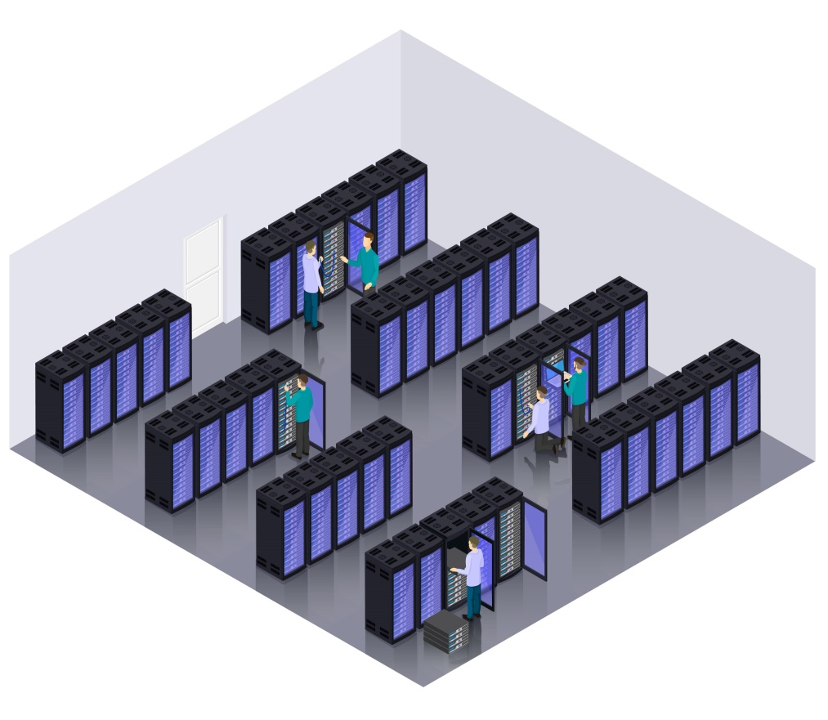
On-premises storage definition
On-premises storage means your company’s server is hosted within your organization’s infrastructure and, in many cases, physically onsite.

Slide 44
Advantages of on-premises storage
Control
Connectivity ( offline usage )
Reduced internet costs
Increased security

Slide 45
Disadvantages of on-premises storage
High maintenance costs
Difficulty with scaling
Increased risk of data loss
Deployment

Slide 46

Linux server
A Linux server is a server based on the open-source Linux operating system.
Many distributions are built around the Linux kernel: Ubuntu, CentOS, Debian, and others.
Linux servers are widely used for hosting web services, network and system administration, database management, and other critical application requirements.

Slide 47
Advantages of Linux Server
Cost
Reliability
Performance
customization

Slide 48
Disadvantages of Linux Server
CLI
Support
Version update complexity

Slide 49
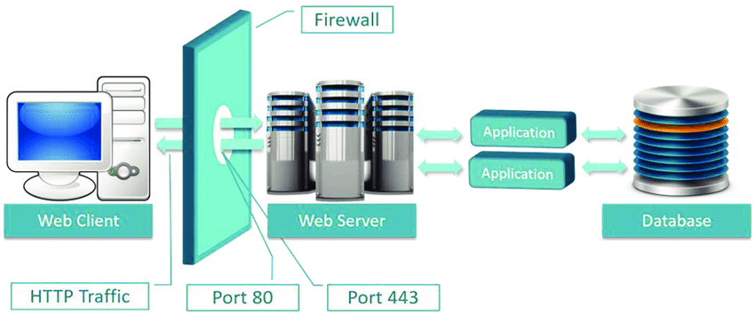
Apache web server
What is it ?
How does it work ?

Slide 50

MariaDB server
What is it ?
How does it work ?

Slide 51
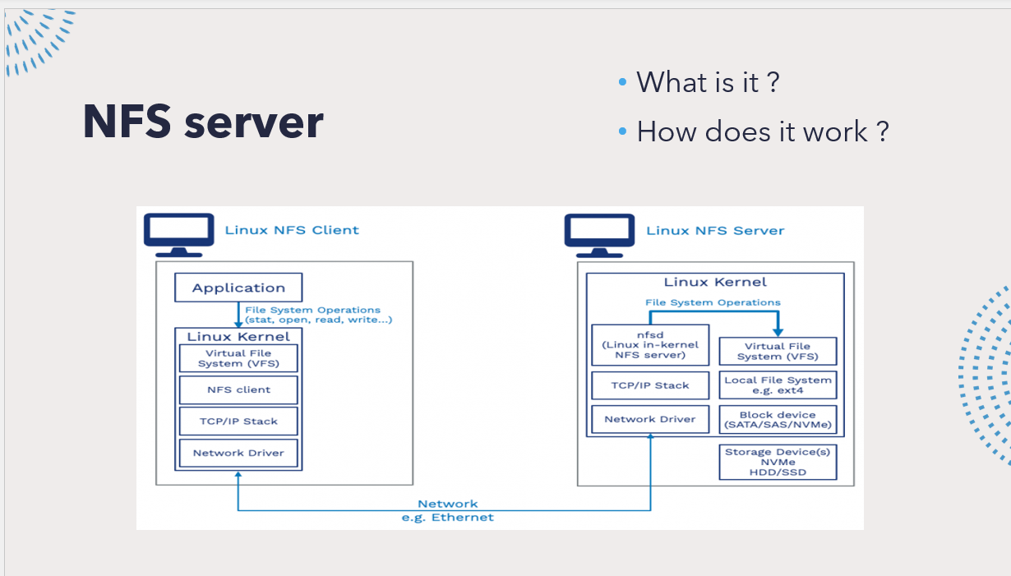
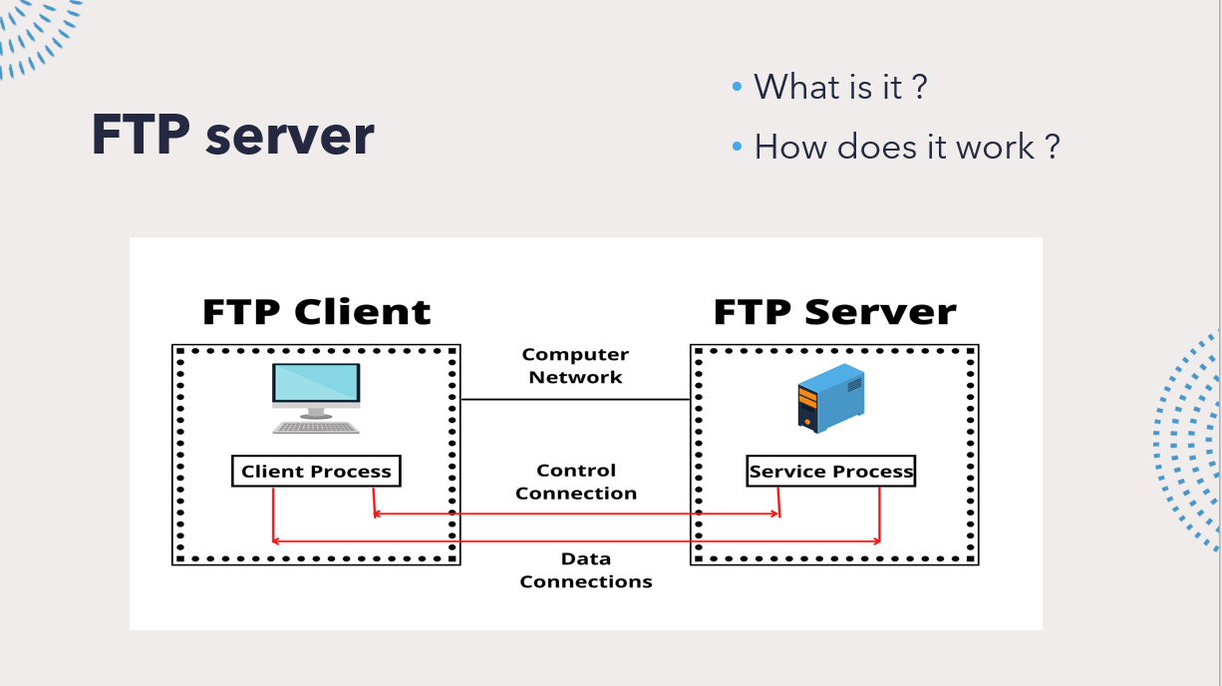

Slide 52
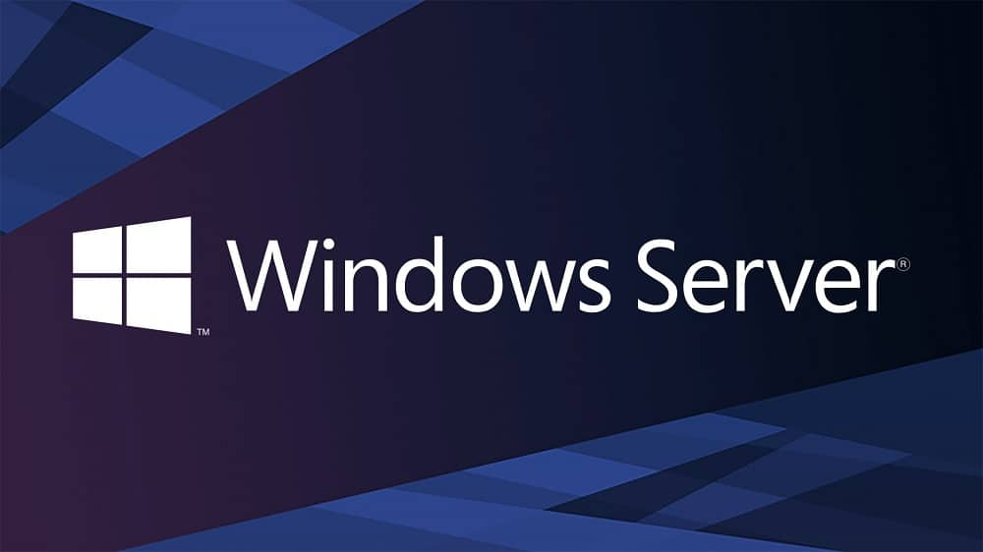
Windows server
Windows Server is a commercial server solution created by Microsoft and powered by the Windows OS.
Each release offers a complete GUI desktop experience that is very intuitive and polished

Slide 53
Advantages of windows Server
Beginner-friendly
Support and maintenance
compatible with Microsoft applications
less admin monitoring and maintenance

Slide 54
Disadvantages of windows Server
Higher costs
Less security
More resource consumption

Slide 55
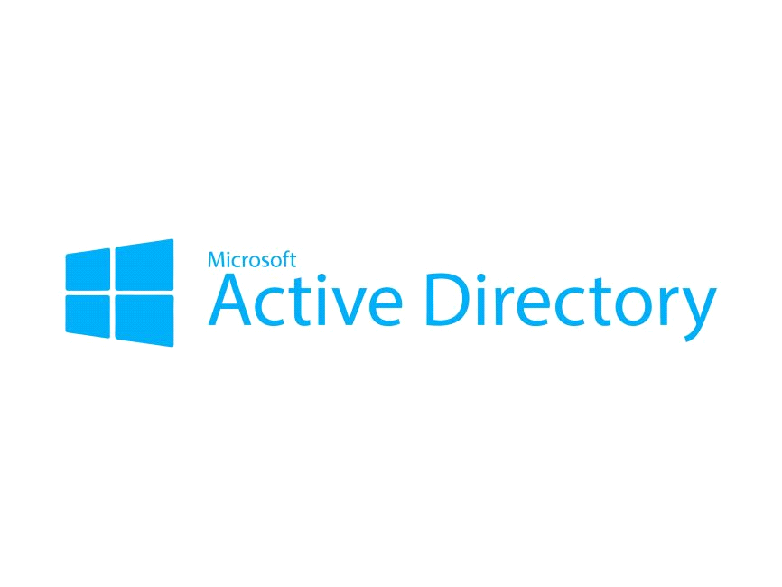
Active Directory: Definition

Slide 56
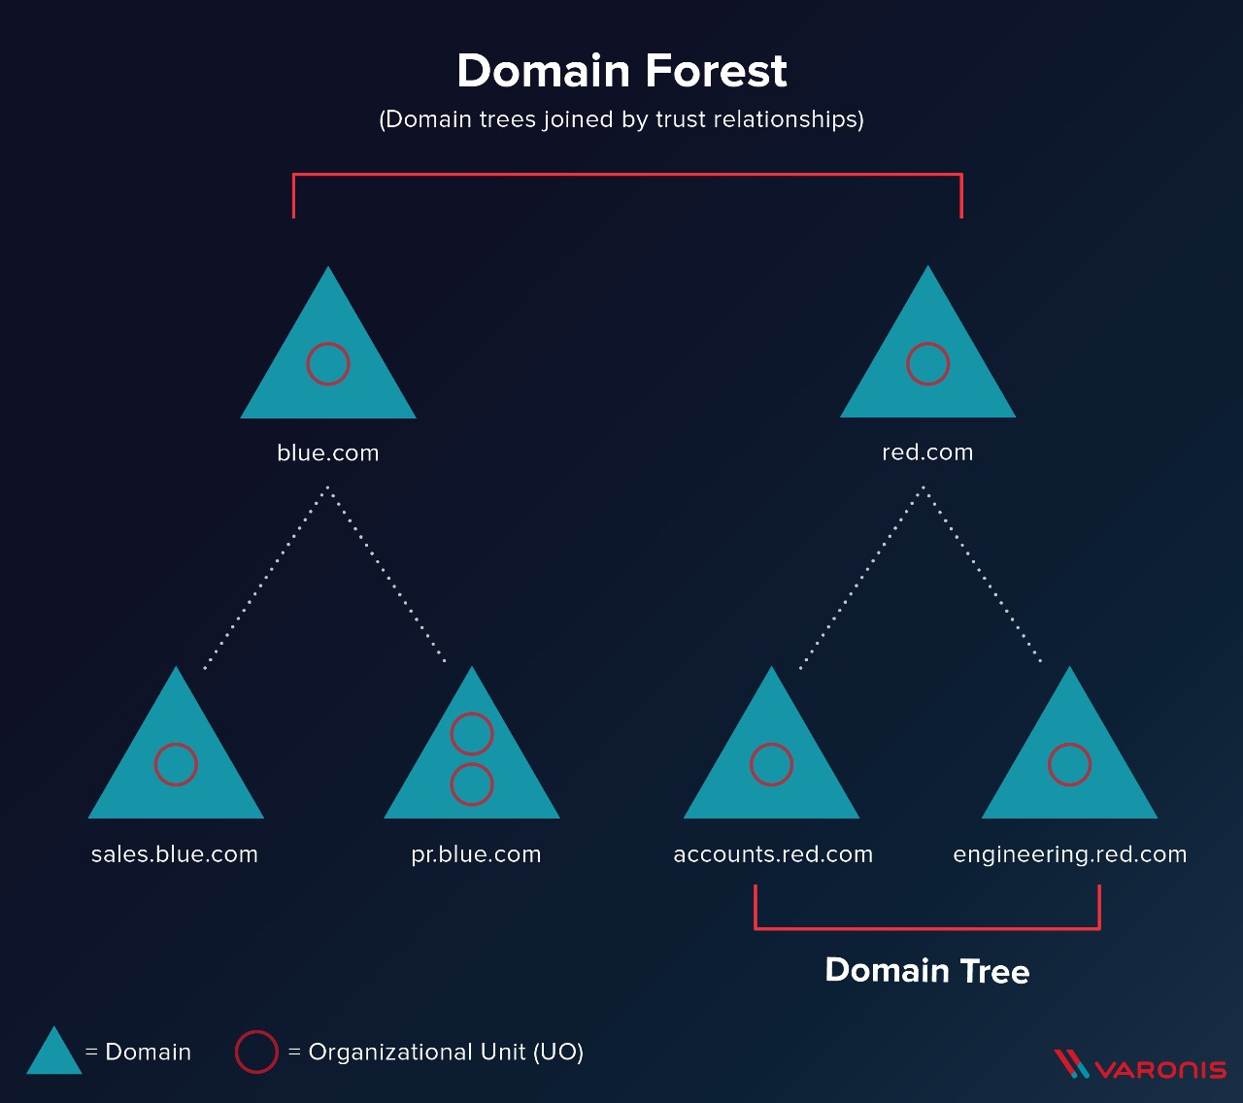
Active Directory Architecture

Slide 57
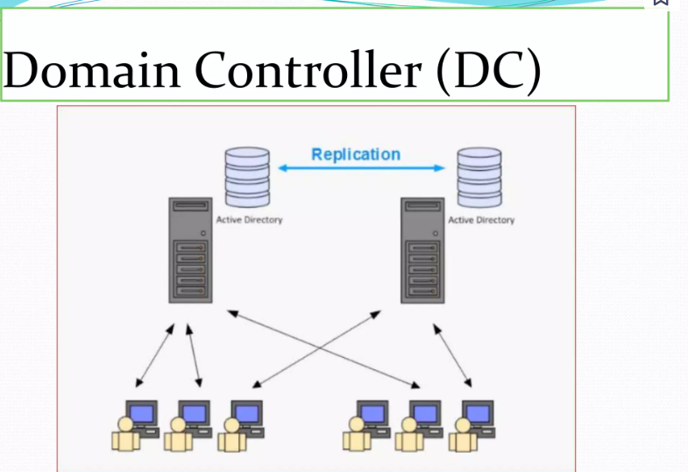
Domain Controller

Slide 58
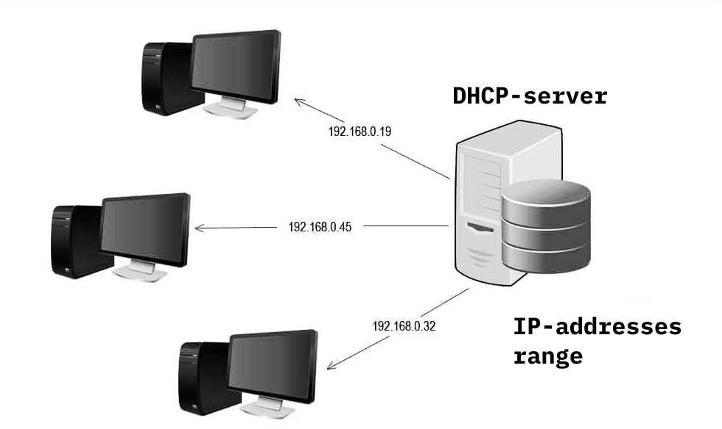
DHCP Server:

Slide 59
DHCP Management: Administrators can configure scope options, reservations, and other settings to tailor DHCP behavior to the network's requirements.

Slide 60
How DHCP Server Works in Windows Server:
IP Address Allocation
DHCP Offer
IP Address Lease
Lease Renewal

Slide 61
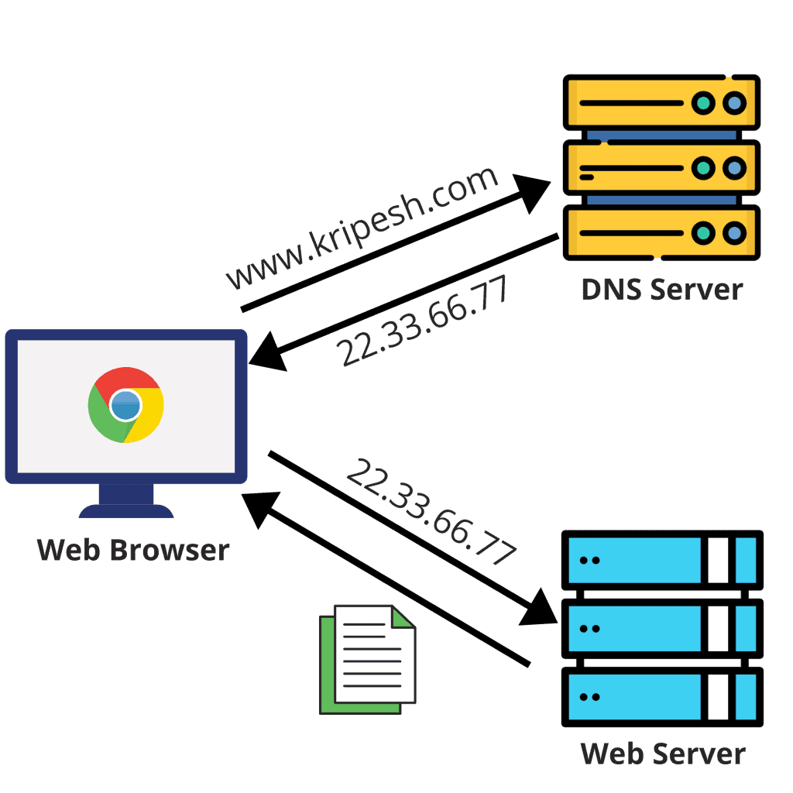
DNS Server:

Slide 62
DNS Management: DNS is a fundamental service in Windows Server environments, providing name resolution for efficient network navigation. While it offers numerous advantages, administrators should be aware of potential challenges and implement security measures to ensure the stability and security of the DNS infrastructure.

Slide 63
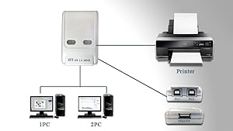
Print Server:

Slide 64
Print Server Management: Print server management is typically done through the Print Management console in the Windows Server administrative tools. Administrators can add printers, configure print queues, manage drivers, and monitor print jobs using the Print Management console.

Slide 65
Advantages of using both linux and windows on the same network
Flexibility and compatibility
Security
Cost-effectiveness
Performance, scalability, and Stability
Complementary strengths (Greater control and customization)

Slide 66
Disadvantages of using both linux and windows on the same network
Complexity
Application compatibility
Licensing Costs, Support and Documentation

Slide 67

Thank you

